Slide 1
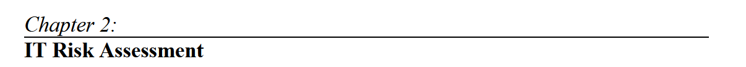


Slide 4
IT Risk Identification
  Risk identification is important because only risk that is identified can be assessed and treated appropriately.
  When the enterprise fails to identify a risk, it is not included in the strategic planning process used by senior management to promote value creation.
  The risk practitioner should work closely with business process owners
  The risk practitioner should also consult with the various information technology and cybersecurity functions to understand the development, acquisition, implementation and integration processes for the wide range of technologies used by the enterprise and the purpose of these technologies.
  In addition, they should also understand how data and information are processed and handled along with the purpose of the data.

Slide 5
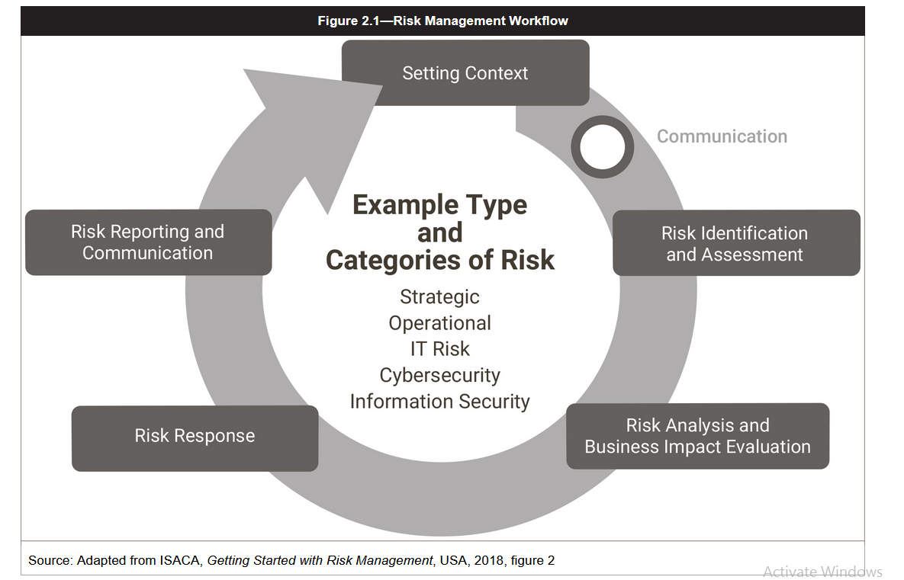

Slide 6
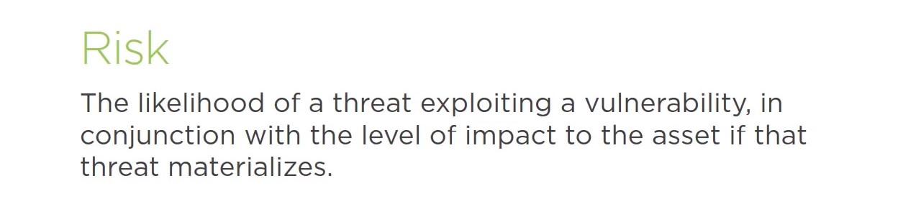
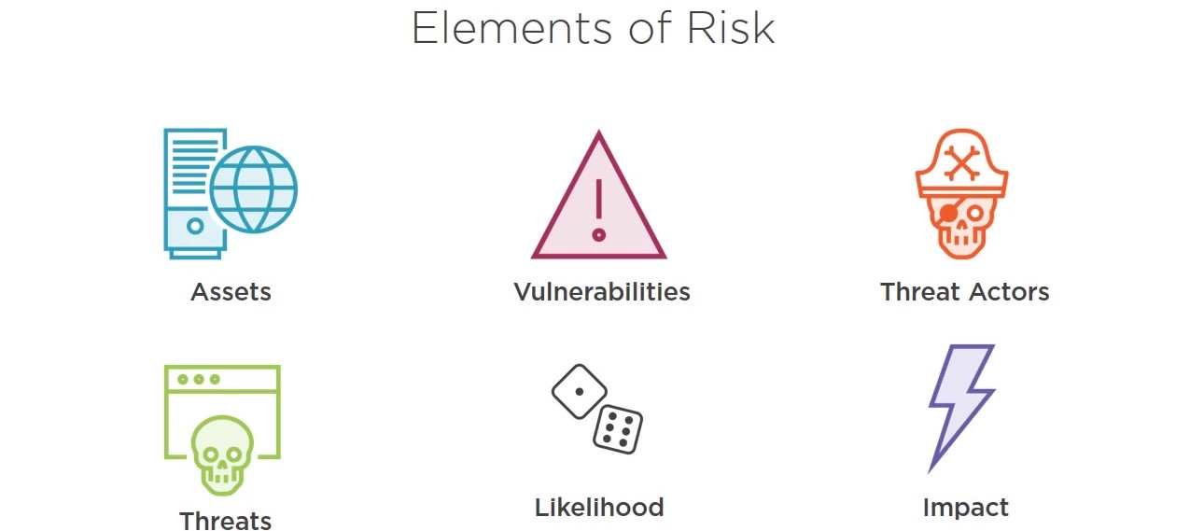
Risk Management Concepts
Risk Definitions

Slide 7
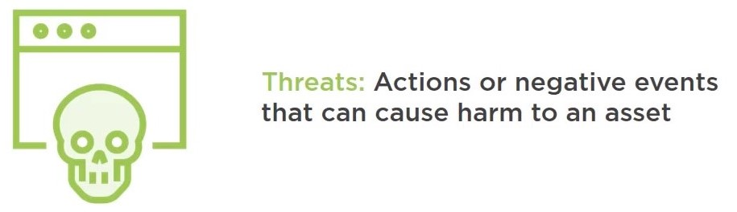
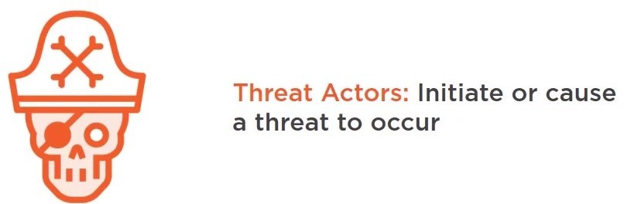
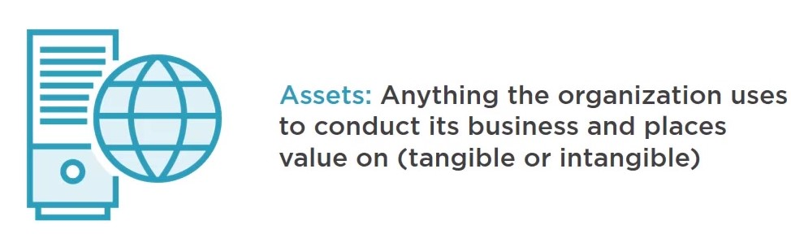
Threats might be naturally occurring such as hurricanes and wildfires, or manmade such as hacking and terrorism.
You can't normally control what threats are out there. They exist independently.

Slide 8

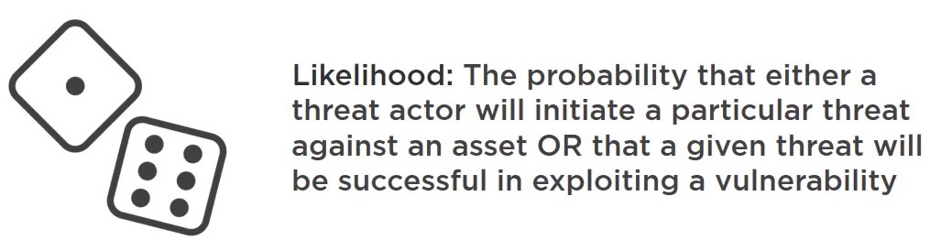
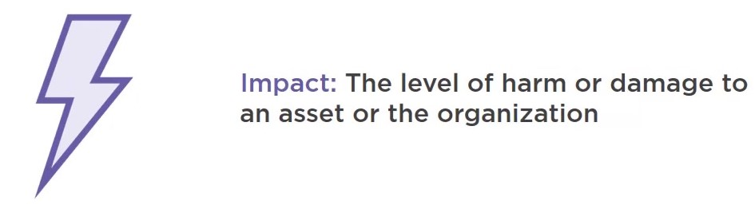

Slide 9
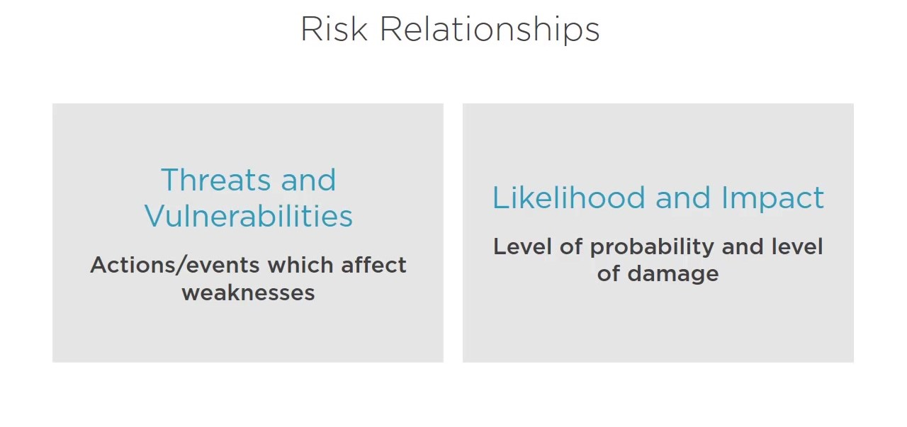

Slide 10
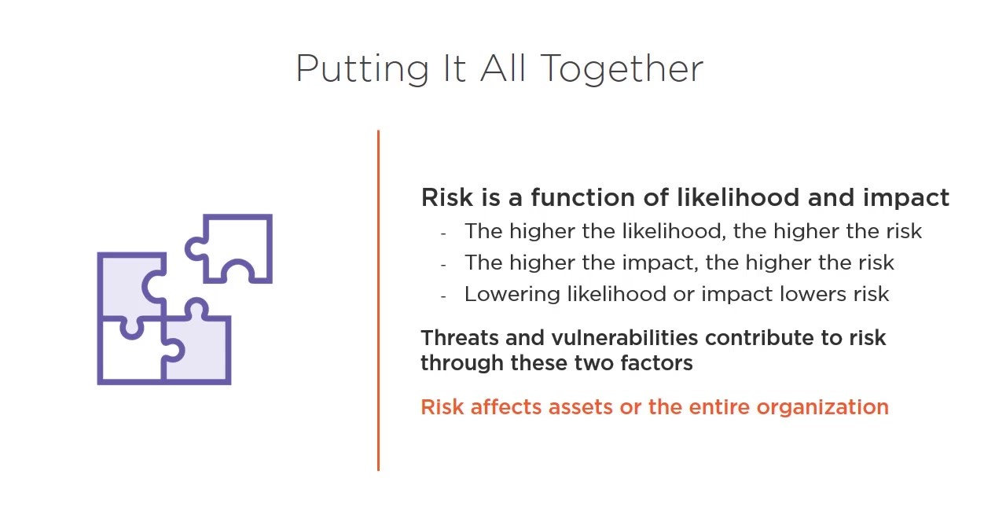

Slide 11
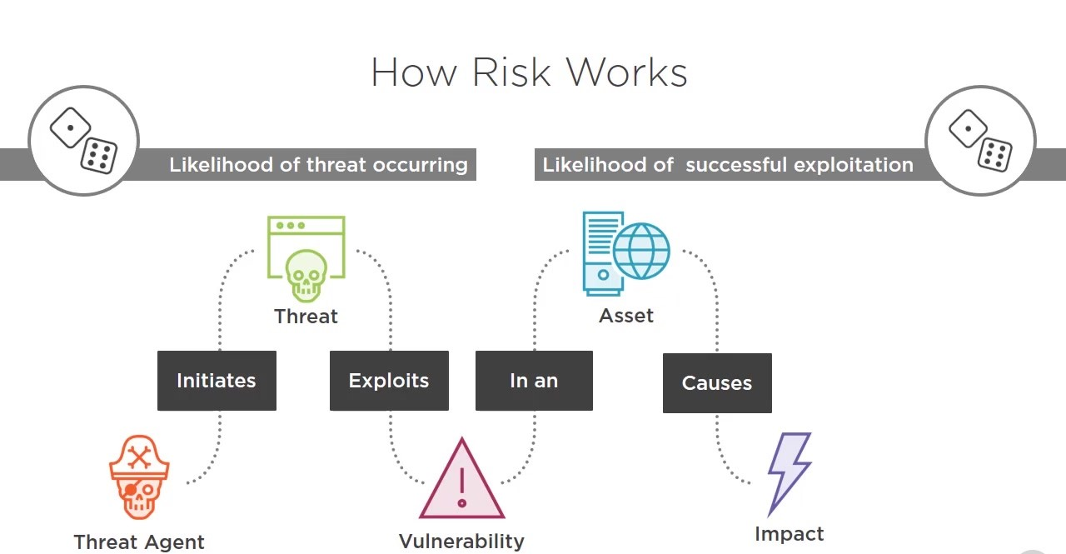

Slide 12
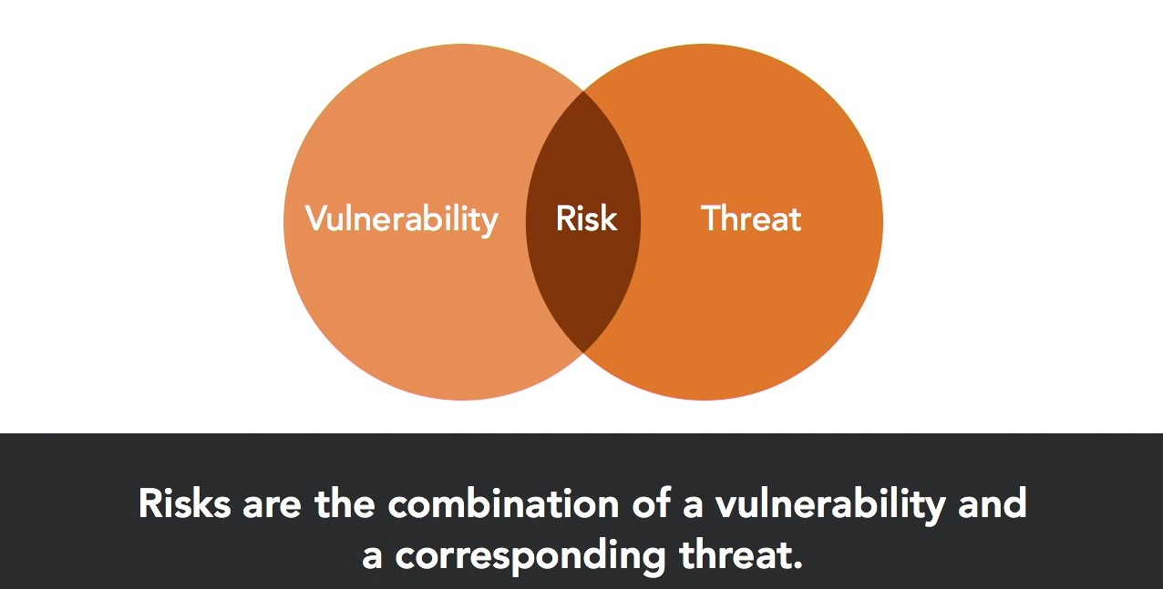

Slide 13
Catalogue of threats & vulnerabilities
This list of threats and vulnerabilities can serve as a help for implementing risk assessment
This list is not final – each organization must add their own specific threats and vulnerabilities that endanger the confidentiality, integrity and availability of their assets.
Threats
Below is a list of threats – this is not a definitive list, it must be adapted to the individual organization:
Disclosure of passwords
Eavesdropping
Access to the network by unauthorized persons
Bomb threat
Breach of contractual relations
Breach of legislation
Compromising confidential information
Concealing user identity
Damage caused by a third party
Damages resulting from penetration testing
Destruction of records
Disaster (human caused)
Disaster (natural)
Disclosure of information
Errors in maintenance
Failure of communication links
Falsification of records
Fire
Flood
Fraud
Industrial espionage
Information leakage
Interruption of business processes
Loss of electricity
Loss of support services
Malfunction of equipment
Malicious code
Misuse of information systems
Misuse of audit tools
Pollution
Social engineering
Software errors
Strike
Terrorist attacks
Theft
Thunderstroke
Unintentional change of data in an information system
Unauthorized access to the information system
Unauthorized changes of records
Unauthorized installation of software
Unauthorized physical access
Unauthorized use of copyright material
Unauthorized use of software
User error
Vandalism

Slide 14
Vulnerabilities
list of vulnerabilities – this is not a definitive list, it must be adapted to the individual organization:
Complicated user interface
Default passwords not changed
Disposal of storage media without deleting data
Equipment sensitivity to changes in voltage
Equipment sensitivity to moisture and contaminants
Equipment sensitivity to temperature
Inadequate cabling security
Inadequate capacity management
Inadequate change management
Inadequate classification of information
Inadequate control of physical access
Inadequate maintenance
Inadequate network management
Inadequate or irregular backup
Inadequate password management
Lack of policy for the use of cryptography
Inadequate physical protection
Inadequate protection of cryptographic keys
Inadequate replacement of older equipment
Inadequate security awareness
Inadequate segregation of duties
Inadequate segregation of operational and testing facilities
Inadequate supervision of employees
Inadequate supervision of vendors
Inadequate training of employees
Incomplete specification for software development
Insufficient software testing
Lack of access control policy
Lack of clean desk and clear screen policy
Lack of control over the input and output data
Lack of internal documentation
Lack of or poor implementation of internal audit
Lack of procedure for removing access rights upon termination of employment
Lack of protection for mobile equipment
Lack of redundancy
Lack of systems for identification and authentication
Lack of validation of the processed data
Location vulnerable to flooding
Poor selection of test data
Single copy
Too much power in one person
Uncontrolled copying of data
Uncontrolled download from the Internet
Uncontrolled use of information systems
Undocumented software
Unmotivated employees
Unprotected public network connections
User rights are not reviewed regularly

Slide 16
Methods of Risk Identification
The risk practitioner has several possible sources for identification of risk, including:
  review of historical events, such as:
      Audit or incident reports
      Public media (e.g., newspapers, television, etc.)
      Annual reports and press releases
  Systematic approaches (expert opinion) in which a risk team examines and questions a business process systematically to determine the potential points of failure, such as:
      Vulnerability assessments
      Review of business continuity and disaster recovery plans
      Interviews and workshops with managers, employees, customers, suppliers and auditors
  Inductive methods (theoretical analysis), where a team examines a process to determine the possible point of attack or compromise, such as penetration testing
  Existing taxonomy, where a risk library with IT-related risk can be used as a starting point. These libraries are commonly used in governance, risk and compliance (GRC) systems or risk assessment systems.
The process of risk identification serves as the input to another aspect of risk management, as seen in figure 2.5.

Slide 17
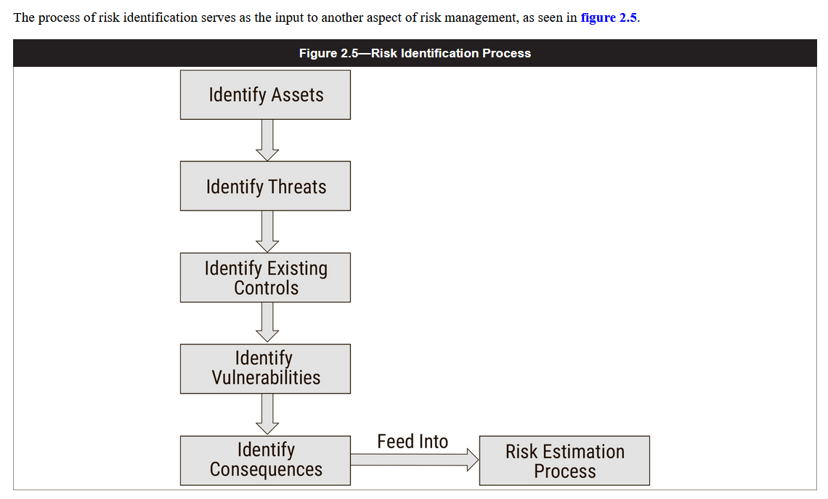

Slide 18
Changes in the Risk Environment
  The risk environment changes as organizations and technologies change and threat actors focus on new areas to attack.
  Systems and applications that were once thought to be secure are often found to be vulnerable at a later time.
  This requires the ongoing monitoring and the evaluation and assessment of the corresponding risk elements
  Substantial changes in the risk environment may arise as a result of changes in technology or in business practices.
  The risk practitioner should ensure that new and emerging risk is identified, analyzed, evaluated, assessed and reported, and that the organization is aware of and watching for emerging threats and newly identified vulnerabilities.
  This includes monitoring vendor alerts, reports from computer emergency response teams (CERTs) and media stories.
  When a new issue arises, the risk practitioner should work with the business and system owner to perform a threat analysis and determine if and how the organization should respond.

Slide 19
Operational Integrity
  Maintaining operational integrity often requires procedures including incident management, identity and access management, change and release management, patch management and project planning.
  These processes must be defined and deployed consistently across the enterprise.
  Without them the enterprise may be at risk of inconsistent management and results, lack of governance and reporting and failure to ensure compliance with regulations.

Slide 20
Forecasting Risk
Previous incidents, audit reports and failures affecting both internal and external parties provide the risk practitioner with valuable insight.
Each event offers a wealth of information on what may have gone wrong and how to better protect systems, detect incidents and respond more effectively in the future.
The greatest threat to the incident response process is a failure to lean from past events and repeat the same errors in the future.
Investigations of past events may also validate or refine the calculation of risk impact, but the risk practitioner is cautioned to remember that no two incidents are identical and that the impact of a future event may differ substantially from a past event with similar characteristics.

Slide 23
Threat Landscape
Threats can be external or internal, intentional or unintentional. They may be caused by natural events or political, economic or competitive factors.
Threats always exist and are typically beyond the direct control of the risk practitioner or asset owner.
Threats may be divided into multiple categories, including:
  Physical
  Natural events
  Loss of essential services
  Disturbance due to radiation
  Compromise or disclosures of information
  Technical failures
  Improperly-defined business logic
  Unauthorized actions
  Compromise of functions

Slide 24
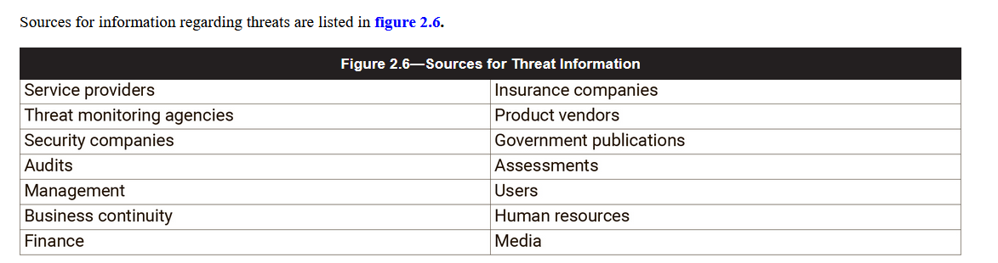
The risk practitioner should document all the threats that may apply to the systems and business processes under review.
Threats may be the result of accidental actions, intentional/deliberate actions or natural events.
Threats may originate from either internal or external sources, and actual attacks may leverage a combination of both internal and external sources.
Where threats may be directed by individual actors, the risk practitioner should know and remain aware that such threat actors tend to be imaginative, creative and determined and will explore new methods and avenues of attack.
To counter threat actors, the risk practitioner must also be determined and creative, and seek to discover as many threats as possible.
An unidentified threat is one for which the organization is more likely to be unprepared and vulnerable than a threat that is well documented.
Sources for information regarding threats are listed in figure 2.6.

Slide 25
Internal Threats
  Employees are the cause of a significant number of business impacts, which can be intentional and unintentional.
  A disgruntled employee may intentionally compromise systems or release data that expose the enterprise to legal or reputational risk.
  Many employees have access to systems and data that far exceeds their actual job requirements, which can be exploited in an attack.
  The solution to this problem is proper provisioning access to ensure that principles such as need-to-know and least privilege are introduced, but on its own, it is an incomplete solution.
  Any system has trusted insiders, and one of them choosing to violate trust is difficult to either predict or prevent.
  The typical malicious insider is a current or former employee, contractor or other business partner who has or had authorized access to an enterprise network, system or data and intentionally intercepted (exfiltrated), interrupted, modified or fabricated data on the enterprise information systems.

Slide 26
The first step in addressing personnel threats is to start with the hiring process and to review the qualifications and attitude of prospective employees.
Employment candidates may have submitted incorrect information on job applications and claimed education, certification or experience that they did not actually possess.
At the time of hiring, the employee should be required to sign a nondisclosure agreement (NDA) and be advised of the ethics and policies of the enterprise, and a review of references and performance of background checks may be worthwhile where permitted by law.
Throughout employment, employees should be reminded of organizational policies and their responsibilities through awareness sessions and regular management reviews.
One of the best employee-based controls is to interact with employees to understand any frustrations, complaints or issues that they may be facing and to seek to resolve those issues.
An employee who has been recently demoted or bypassed for a promotion is also a threat.
At the end of employment, an employee should return all organizational assets, including identification badges, equipment (e.g., laptops, mobile phones, access cards, etc.) and uniforms so that they cannot use those to gain unauthorized access in the future.
In addition, systems, network and facility access should be revoked immediately prior to the employee departure to minimize the potential for crimes of opportunity.

Slide 27
Internal threats can also originate from third parties that already operate within the internal environment of an enterprise.
The risk practitioner should also consider vendor staff, business process outsourcing staff or any other external individuals that operate from within the enterprise.
Although they can be considered as external threats, they usually have some internal access points, and higher knowledge and capabilities to potentially initiate a threat from within an enterprise.

Slide 28
External Threats
threats to information systems from outside the enterprise can originate from anywhere and may take a number of forms, including, but not limited to, the following:
    Espionage
    Theft
    Sabotage
    Terrorism
    Criminal acts
    Software errors
    Hardware flaws
    Mechanical failures
    Lost assets
    Data corruption
    Facility flaws (freezing pipe/pipe burst)
    Fire
    Supply chain interruption
    Industrial accidents
    Disease (epidemic)
    Seismic activity
    Flooding
    Power surge/utility failure
    Severe storms
Natural events such as a flood, storm, earthquake or tornado are unpredictable and may be extremely disruptive and damaging.
The use of governmental data and weather monitoring services may identify the threats associated with natural events and allow the risk practitioner to take necessary steps to be prepared.

Slide 29
The range of external threat actors include criminals, hacktivists, corporate spies, thieves or advanced persistent threats (APT), each having different methods, motivations and capabilities.
Where nation-state threat actors will be skilled and determined to break into systems for military or economic purposes, hacktivists will have a different set of skills and motivations to bare in an attempt to publicly humiliate or shame an organization.
The term APT refers to advanced, highly-skilled attackers that are determined (persistent) in their attempts to exploit systems and networks.
They pose increased skills and the effectiveness of the tools they possess makes the risk of compromise significant.
APTs may be sponsored by governments, organized crime or competitors.
Most breaches are the result of targets of opportunity, not determined attacks. As seen in the annual reports from Verizon? and other organizations, many enterprises are breached because they were discovered to be easy targets and threat actors took advantage of their vulnerabilities.

Slide 30
Emerging Threats
  Most technologies are built with an emphasis on function and purpose without due consideration for the security implications.
  As a result, new technology tends to be a source of new vulnerabilities and may even itself be a threat actor within an information system.
  The risk practitioner must be alert to the emergence of new technologies and prepare for their introduction into the enterprise, particularly if these technologies promise cost savings or competitive advantage.
  Internet of Things (IoT) is an example of a revolution in how enterprises view technology assets, one whose risk is self-evident but that has tempted a wide variety of enterprises by promising to greatly reduce the cost of both initial procurement of IT assets and the rate at which they need to be refreshed.
  A strategy that emphasizes rejection of new technology is unlikely to remain in place long beyond the point at which something gains executive sponsorship.

Slide 31
Additional Sources for Threat Information
  Additional sources for threat information are discussed in the following sections.
  Conducting Interviews
  Gathering information from staff is a valuable method of gaining insight into the business from those closest to the processes and most likely to understand their fundamental workings.
  The risk practitioner can improve the results of an interview producing useful information by adhering to the following good practices:
    Conduct interviews with senior leaders in order to ensure a thorough understanding of the enterprise, including every aspect of each business operation.
    Senior leaders may include board members, administrators, critical third-party service providers, customers, suppliers and managers.
    Encourage interviewees to be open about challenges they face and risk that concerns them along with any potential missed opportunities or problems associated with their current processes, systems and services/products.

Slide 32
  Media Reports
Media sources such as newspapers, television, articles and social media can be useful sources of information about threats or
  Observation
Watching a process as an independent observer may highlight issues that are unable to be seen as clearly by those performing the operations and can help to identify situations in which documented processes are not being followed or where processes are found to be lacking.
Besides making observations, the risk practitioner should conduct or review the business process mapping to identify out-of-band services and new ways of working created during periods of business reorganization that are not captured in the previous operating models.
  Logs
Logs are powerful sources of threats.
These logs, when ingested in security information and event management tools, can be used to correlate events from different sources to identify a threat or an incident

Slide 33
Self-assessments
  Many enterprises encourage direct manager involvement in monitoring risk and control effectiveness within their areas of responsibility.
  Local managers typically have insight into the behavior of their staff and routine operations, so they are well-suited to evaluate compliance with procedures, recurring problems, risk trends and vulnerabilities.
  Properly conducted self-assessments can provide the risk team and Senior management with regular reporting of risk and assurance of control effectiveness and may also reduce the need for more intense auidits oF system reauthorization.

Slide 34
Third-party Assurance
  Third-party performance of reviews, audits, compliance verification and analysis of the enterprise, its processes, incidents, logs and threat environment can be a valuable source of information about risk, control effectiveness (design and operational efficacy), vulnerabilities and compliance.
User Feedback
  System users are in an excellent position to know the system and its shortcomings, including potential vulnerabilities.
  Interacting with users and learning their issues and concerns regarding the system may indicate where security controls could be circumvented for convenience or improved efficiency.
Vendor Reports
  There are many sources for information on current threats and vulnerabilities, new types of malware or emerging attack methods.
  Many government-sponsored CERTs and security vendors provide free or subscription-based reports and analysis, and these can be valuable sources of information for the risk practitioner.

Slide 35
Threat Modeling
  Threat modeling is an important part of the risk analysis.
  Threat modeling involves looking at every possible threat agent, action or event, attack vector, and vulnerability for a given system, asset, or process, and then modeling or simulating how it could progress and the damage that could occur.
  To prevent threats from taking advantage of system flaws, various threat-modeling methods can steer appropriate response and help make informed decisions around appropriate safeguards and countermeasures needed to protect an asset.
  Threat modeling helps the risk practitioner, systems designers, developers and operators to build systems with attention to defensive controls, built-in security features and proper placement within a strategy of overlapping defenses (defense in depth) that can deter or prevent system failures.
Benefits of threat modeling
  Threat modeling allows you to:
  Identify and address the biggest threats.
  Plan mitigations on identified and documented threats, not on a gut feeling.
  Eliminate security issues in the design phase.
  Make security decision rationally.
  Increase the security posture of your application and organization in a cost effective manner.
  Prioritize development and testing efforts based on identified threats.
  Threat modeling helps improve your application security posture
  Threat modeling can improve your organization’s security posture
  Threat modeling helps prioritize threats, mitigation efforts and budgeting

Slide 36
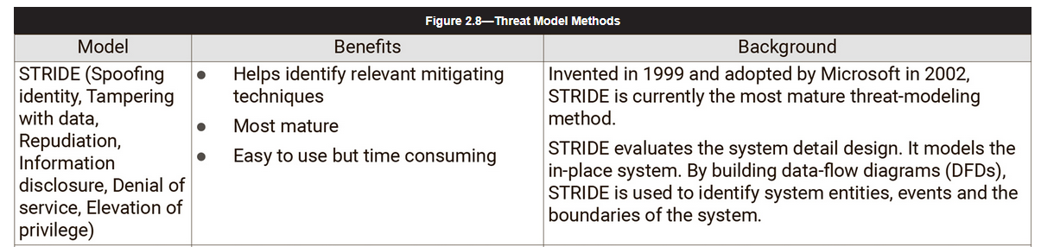
The answers to these questions can be collected in a threat profile and maintained for each threat community identified by the enterprise.
The profile can be correlated to risk statements, third parties and business processes to gain a clearer picture of end-to-end enterprise risk.
Several threat-modeling methods can be combined to create a more robust and well-rounded view of potential threats.
Some methods focus specifically on risk or privacy concerns.
Figure 2.8 provides a list of threat model methods.

Slide 37

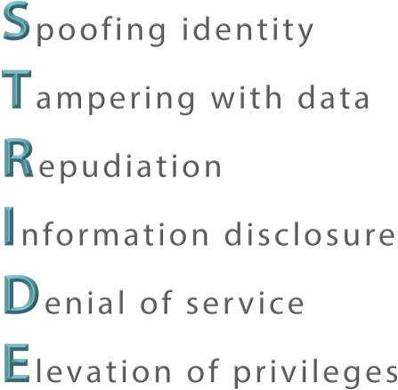

Security Threat Modeling:

Slide 38
S stands for spoofing.
Spoofing attacks used falsified identity information to gain access to a system.
  This may be as simple as a social engineering attack that fakes the sender's name on an email address,
  or it may be more complicated and involve spoofing IP addresses, MAC addresses, wireless network names, or any other claim of identity.
  The best control against spoofing is using strong authentication.
T stands for tampering.
Tampering attacks make unauthorized changes to systems or data in an attempt to gain access or disrupt data integrity.
  For example, a student may hack into a college database in an attempt to tamper with his or her grades.
R stands for repudiation.
Repudiation (denial, disclaimer, refusal) attacks attempt to deny responsibility for an action, and may go farther and attempt to blame a third party.
  Requiring digital signatures is a useful control against repudiation attacks.

Slide 39
I stands for information disclosure.
  Information disclosure attacks attempt to steal confidential information and disclose it to unauthorized individuals.
  This may be done quietly, such as a competitor reading and reacting to an organization's product development plans.
  or it may be public, such as a newspaper disclosing classified government records.
D stands for denial of service or DOS.
  DOS attacks attempt to deprive legitimate users access to the information or systems that they need.
E stands for elevation of privilege.
  This is sometimes also known as privilege escalation.
  Elevation attacks attempt to take a normal user account and transform it into an administrative or super user account that allows the user to exceed its legitimate privileges.

Slide 40
Threat modeling in 4 steps
  Diagram: what are we building?
  Identify threats: what can go wrong?
  Mitigate: what are we doing to defend against threats?
  Validate: validation of previous steps and act upon them
  Step 1: diagram the application
    In this step, you gain a comprehensive understanding of the mechanics of your application or process . In other words: you understand what you are building.
    That makes it a lot easier for you to uncover more relevant and more detailed threats. This also includes the identification of clear security objectives.

Slide 41
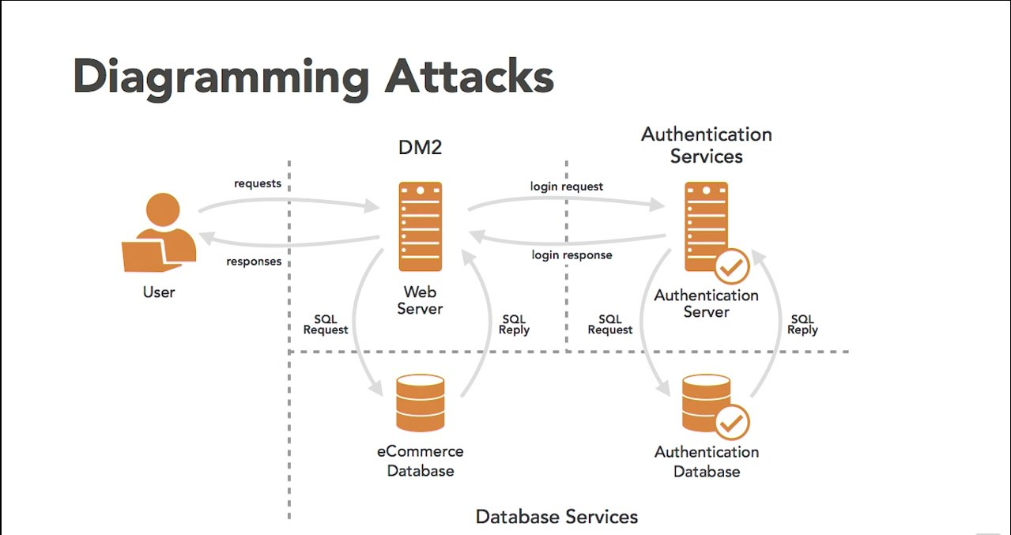
When thinking through an attack, it is often helpful to use a system a diagram that shows the data flows, and relationships between systems.
This type of diagramming is a form of reduction analysis. An important threat modeling tool.

Slide 42
Step 2: identify threats with STRIDE
  You use details from the previous step in the STRIDE phase to identify threats relevant to your application scenario and context. With STRIDE, you can flawlessly identify what can go wrong.
  STRIDE was developed by Microsoft to educate developers on how to think about computer security threats, and is an acronym for:
    Spoofing: can an attacker gain access using a false identity?
    Tampering: can an attacker modify data as it flows through the application?
    Repudiation: if an attacker denies doing something, can we prove he did it?
    Information disclosure: can an attacker gain access to private or potentially injurious data?
    Denial of service: can an attacker crash or reduce the availability on the system?
    Elevation of privilege: can an attacker assume the identity of a privileged user?
    Each of these threats is the opposite of a property that you want your system to have. Spoofing – for example – is the opposite of authentication.

Slide 43
Step 3: mitigate identified vulnerabilities
In this step, you review the layers of your application to identify the necessary security controls related to your threats.
Vulnerability categories help you focus on those areas where mistakes are most often made.
Step 4: validate
The final step is to validate the whole threat model.
Is each threat mitigated or not? And for unmitigated threats: are the residual risks clearly explained and tied into business risks? In the validation step, you also decide and follow-up on the next steps to manage the identified threats.

Slide 44
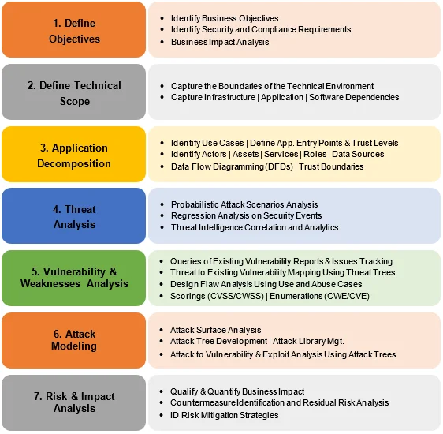
Process for Attack Simulation and Threat Analysis (PASTA)
  PASTA’s steps guide teams to dynamically identify, count, and prioritize threats.
  PASTA is an attacker-centric methodology with seven steps.
  It is designed to correlate business objectives with technical requirements.
The steps of a PASTA threat model are:
  Define business objectives
  Define the technical scope of assets and components
  Application decomposition and identify application controls
  Threat analysis based on threat intelligence
  Vulnerability detection
  Attack enumeration and modeling
  Risk analysis and development of countermeasures

Slide 45
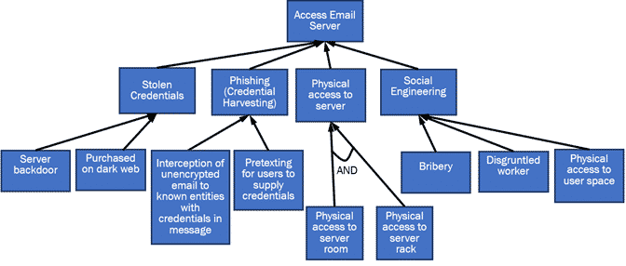
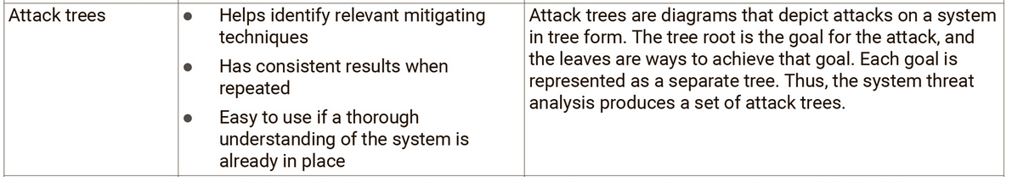
Attack Trees
Attack trees are charts that display the paths that attacks can take in a system.
The tree root is the goal of the attack and the leaves are the ways to achieve that goal for the attacker
When creating trees for threat modeling, multiple trees are created for a single system, one for each attacker goal.
This is one of the oldest and most widely used threat modeling techniques.
While once used alone, it is now frequently combined with other methodologies, including PASTA, CVSS, and STRIDE.

Slide 46
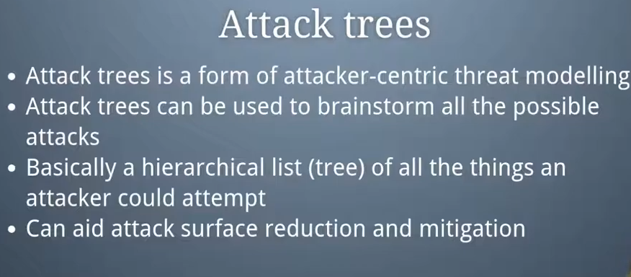
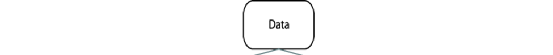
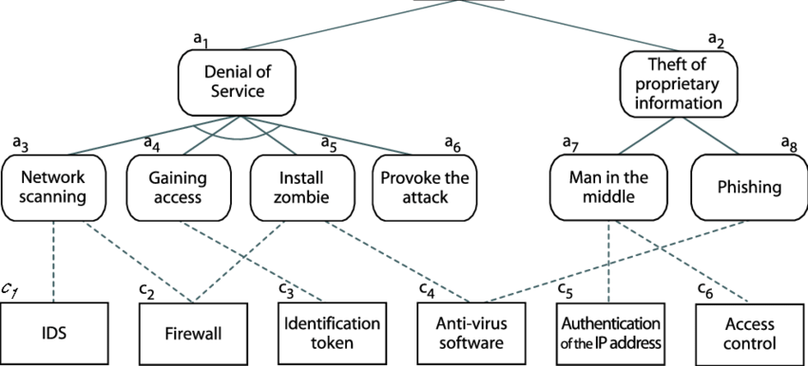

An example attack tree.
A defense tree for the attack tree

Slide 47
